Slide 1
Example
Of
ERD

Slide 2
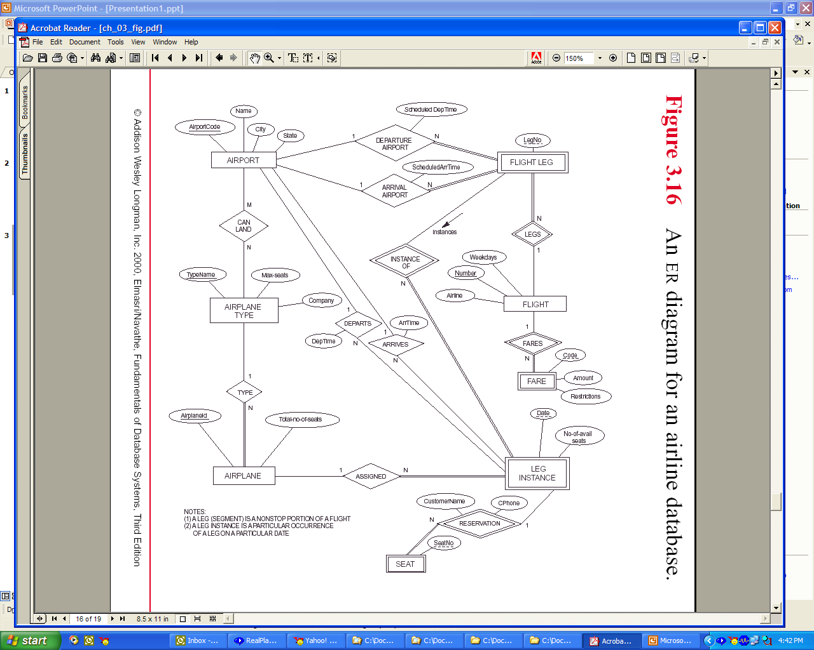
SeatNo
SEAT

Slide 3
We start with taking care of the strong entities first. They include:
AIRPORT:
AirportCode, Name, City, State, …
AIRPLANE-TYPE:
TypeName, MaxSeats, Company,…
AIRPLANE
AirPlaneId, TotalNoOfSeats,…
FLIGHT:
Number, WeekDays, Airline,….
We better check mark the entities we have taken care of

Slide 4
SeatNo
SEAT

Slide 5
Now we also take care of the weak entities. As you see, the owner entity of some weak entities are strong entities and the owner of others are weak entities
It is a better idea to perform the ones that their owners are strong entities. So in our example, we get:
FLIGHT-LEG
FlightNumber, LegNo, …
FARES
FlightNumber, Code, Amount, Restrictions, ….
LEG-INSTANCE
FlightNumber, LegNo, Date, NoOfAvailSeats, …
SEAT
FlightNumber, LegNo, Date, SeatNo, CustomerName, CPhone,…
Again, lets check mark what we have done

Slide 6
SeatNo
SEAT

Slide 7
Here is what we have so far:
AIRPORT:
AirportCode, Name, City, State, …
AIRPLANE-TYPE:
TypeName, MaxSeats, Company,…
AIRPLANE
AirPlaneId, TotalNoOfSeats,
FLIGHT:
Number, WeekDays, Airline,….
FLIGHT-LEG
FlightNumber, LegNo,
FARES
FlightNumber, Code, Amount, Restrictions, ….
LEG-INSTANCE
FlightNumber, LegNo, Date, NoOfAvailSeats,
SEAT
FlightNumber, LegNo, Date, SeatNo, CustomerName, CPhone,…

Slide 8
Now we take care of 1:1 and 1:N relationships:
AIRPORT:
AirportCode, Name, City, State, …
AIRPLANE-TYPE:
TypeName, MaxSeats, Company,…
AIRPLANE
AirPlaneId, TotalNoOfSeats, TypeName,
FLIGHT:
Number, WeekDays, Airline,….
FLIGHT-LEG
FlightNumber, LegNo, DepAirPortCode, ScheduledDepTime, ArrAirportCode, ScheduledArrTime,
FARES
FlightNumber, Code, Amount, Restrictions, ….
LEG-INSTANCE
FlightNumber, LegNo, Date, NoOfAvailSeats, AirPlaneId, DepAirPortCode, DepTime, ArrAirportCode, ArrTime
SEAT
FlightNumber, LegNo, Date, SeatNo, CustomerName, CPhone,…

Slide 9
SeatNo
SEAT

Slide 10
Now we take care of M:N relationships:
AIRPORT:
AirportCode, Name, City, State
AIRPLANE-TYPE:
TypeName, MaxSeats, Company
AIRPLANE
AirPlaneId, TotalNoOfSeats, TypeName
FLIGHT
Number, WeekDays, Airline
FLIGHT-LEG
FlightNumber, LegNo, DepAirPortCode, ScheduledDepTime, ArrAirportCode, ScheduledArrTime
FARES
FlightNumber, Code, Amount, Restrictions
LEG-INSTANCE
FlightNumber, LegNo, Date, NoOfAvailSeats, AirPlaneId, DepAirPortCode, DepTime, ArrAirportCode, ArrTime
SEAT
FlightNumber, LegNo, Date, SeatNo, CustomerName, CPhone
CAN-LAND
AirportCode, TypeName

Slide 11
SeatNo
SEAT

Slide 12
Another example of ERD
College (Name, Office, Phone, InsDeanId*)
Department (DeptCode, Name, office, Phone, ChairID*, CollegeName*)
Course (CourseCode, Name, description, level credits, DeptId* )
Instructor (InsId, rank name, office, Phone, (DeptID, DeptCode)*, StartDate)
Student (SId, DOB, Fname, Mname, Lname, Address, Phone, Major, InstID* )
Section (SecId, SecNo, Building, RoomNo, Building, RoomNo, Year, DaysTime, InstID*, CourseID*)
Enroll (StudnetId*, SectionId*)
ID
Rank
Office
College
1
Dean
1
Instructor
M
Name
Phone
1
StartDate
1
1
Office
Name
chairs
Phone
Admits
employs
Phone
N
1
1
has
Office
Depart
teaches
1
1
Code
ID
Name
Fname
DOB
N
Offers
Student
Name
Mname
Address
Lname
M
Code
Phone
enroll
SecId
Major
SecNo
Name
M
N
N
Building
Des
Course
has
Room
Section
RoomNo
1
M
Level
Sem
DaysTime
Credits
Year

